Slide 1
Network Security
CS 6823
Layer 2 Security
Phillip Mak
pmak@nyu.edu
The material within was originally presented at Cisco
Networkers Live Conference 2008-2009. Modified since.

Slide 2
Objectives
Be able to explain and describe the major types Layer 2 security issues
Topics
CAM Table Overflow Attack
VLAN Hopping Attacks
Basic VLAN Hopping
Double Tagging
DHCP Attacks
DHCP Address Starvation
Rogue DHCP Server
ARP
Layer 2 and 3 Spoofing
Spanning Tree Protocol

Slide 3
Layer 2 Switch Security

Slide 4
Why Worry About Layer 2 Security?
OSI was built to allow different layers to work without the knowledge of each other
Host A
Host B
Application
Application Stream
Application
Presentation
Presentation
Session
Session
Transport
Protocols/Ports
Transport
Network
IP Addresses
Network
Data Link
MAC Addresses
Data Link
Physical
Physical Links
Physical

Slide 5
Lower Levels Affect Higher Levels
This means if one layer is hacked, communications are compromised without the other layers being aware
Security is only as strong as the weakest link
Layer 2 can be VERY weak
Application
Application Stream
Application
POP3, IMAP, IM, SSL, SSH
Presentation
Presentation
Session
Compromised
Session
Transport
Protocols/Ports
Transport
Network
IP Addresses
Network
Data Link
Initial Compromise
Data Link
Physical
Physical Links
Physical

Slide 6
MAC Attacks

Slide 7
MAC Address CAM Table
48-Bit Hexadecimal Number Creates Unique Layer Two Address
1234.5678.9ABC
First 24-Bits = Manufacture Code
Assigned by IEEE
Second 24-Bits = Specific Interface, Assigned by Manufacture
0000.0cXX.XXXX
0000.0cXX.XXXX
All Fs = Broadcast
FFFF.FFFF.FFFF
CAM table stands for Content Addressable Memory
The CAM table stores the mapping of MAC addresses to the physical interface, and associated VLAN parameters. the .
All CAM tables have a fixed size

Slide 8
Normal CAM Behavior 1/3
MAC Port
A 1
C 3
Port 2
ARP for B
MAC B
ARP for B
Port 1
MAC A
Port 3
ARP for B
B Is Unknown— Flood the Frame
MAC C

Slide 9
Normal CAM Behavior 2/3
MAC Port
A 1
C 3
B 2
Port 2
I Am MAC B
MAC B
I Am MAC B
Port 1
MAC A
Port 3
A is on Port 1
LEARN
B is on Port 2
MAC C

Slide 10
Normal CAM Behavior 3/3
MAC Port
A 1
C 3
B 2
Port 2
Traffic A-> B
MAC B
Traffic A -> B
Port 1
MAC A
Port 3
B Is on Port 2
Does Not See Traffic to B
MAC C

Slide 11
CAM Overflow Attack
MAC Port
A 1
B 2
C 3
CAM Table Now Full
Switch acts like hub
Y 3
Z 3
Port 2
Traffic A → B
Y Is on Port 3
MAC B
Traffic A → B
Port 1
MAC A
Port 3
I Am MAC Y
I Am MAC Z
ARP Flooding
Z Is on Port 3
Traffic A → B
MAC C
I See Traffic to B

Slide 12
Countermeasures for MAC Attacks: Port Security
Port Security Limits the Amount of MACs on an Interface
Solution
Port security limits MAC flooding attack and locks down port and sends an SNMP trap
May need to allow multiple MAC address on a port, say, for IP Phones
00:0e:00:aa:aa:aa
00:0e:00:bb:bb:bb
132,000 Bogus MACs
Only One MAC Addresses Allowed on the Port: Shutdown

Slide 13
Port Security
In the past you would have to type in the only MAC you were going to allow on that port
You can now put a limit on how many MAC addresses a port will learn
You can also put timers in to state how long the MAC address will be bound to that switch port
“CAM Aging” – typical aging time is 5 minutes
You might still want to do static MAC entries on ports that there should be no movement of devices, such as in server farms

Slide 14
VLAN Hopping Attacks

Slide 15
Basic Trunk Port Defined
Trunk with: Native VLAN
VLAN 10
VLAN 20
VLAN 10
VLAN 20
VLAN 20
VLAN 10
Trunk ports have access to all VLANs by default
Used to route traffic for multiple VLANs across the same physical link (generally between switches or phones)
Encapsulation can be 802.1q or ISL

Slide 16
Basic VLAN Hopping Attack: Switch Spoofing
Trunk with: Native VLAN
VLAN 10
VLAN 20
VLAN 10
VLAN 20
Trunk with: Native VLAN
VLAN 10
VLAN 20
VLAN 10
An end station can spoof as a switch with ISL or 802.1q
The station is then a member of all VLANs
Requires a trunking configuration of the native VLAN to be VLAN 1
Mitigations
Disable auto-trunking on user facing ports (DTP off)
Do not use VLAN 1 for user traffic as management traffic requires VLAN 1
Explicitly configure trunking on infrastructure ports

Slide 17
Double 802.1q Encapsulation VLAN Hopping Attack
src mac
dst mac
8100
5
8100
96
0800
data
1st tag
2nd tag
802.1q,802.1q
802.1q Frame
Frame
Strip Off First,
and Send
Back Out
Attacker needs to be a part of the native VLAN
Send 802.1q double encapsulated frames
Switch performs only one level of decapsulation
Unidirectional traffic only
Works even if trunk ports are set to off
Mitigations
Explicitly set the VLAN IDs used on a trunk port
Do not use VLAN 1 for user traffic as management traffic requires VLAN 1
Require all VLANs to be tagged on trunks

Slide 18
DHCP Attacks

Slide 19
DHCP Function
DHCP Server
Client
DHCP Discover (Broadcast)
DHCP Offer (Unicast)
DHCP Request (Broadcast)
DHCP Ack (Unicast)
IP Address: 10.10.10.101 Subnet Mask: 255.255.255.0 Default Routers: 10.10.10.1 DNS Servers: 192.168.10.4, 192.168.10.5 Lease Time: 10 days
Server dynamically assigns IP address on demand
Administrator creates pools of addresses available for assignment
Address is assigned with lease time
DHCP delivers other configuration information in options

Slide 20
DHCP Function: Lower Level
IPv4 DHCP Packet Format
OP Code
Hardware
Type
Hardware
Length
HOPS
Transaction ID (XID)
Seconds
Flags
Client IP Address (CIADDR)
Your IP Address (YIADDR)
Server IP Address (SIADDR)
Gateway IP Address (GIADDR)
Client Hardware Address (CHADDR)—16 Bytes
Server Name (SNAME)—64 Bytes
Filename—128 Bytes
DHCP Options

Slide 21
DHCP Attack Types - DHCP Starvation Attack
Client
Gobbler
DHCP
Server
DHCP Discovery (Broadcast) x (Size of Scope)
DHCP Offer (Unicast) x (Size of DHCPScope)
DHCP Request (Broadcast) x (Size of Scope)
DHCP Ack (Unicast) x (Size of Scope)
Gobbler/DHCPx looks at the entire DHCP scope and tries to lease all of the DHCP addresses available in the DHCP scope
This is a Denial of Service DoS attack using DHCP leases
There are types of Starvation attacks: using the Discovery Messages, or using the Request messages

Slide 22
Countermeasures for DHCP Attacks DHCP Starvation Attack = Port Security
Client
Gobbler
DHCP
Server
Gobbler uses a new MAC address to request a new DHCP lease
Port security - Restrict the number of MAC addresses on a port
Will not be able to lease more IP address then MAC addresses allowed on the port
In the example the attacker would get one IP address from the DHCP server

Slide 23

DHCP Attack Types - Rogue DHCP Server Attack
Client
DHCP
Server
Rogue Server or Unapproved
DHCP Discovery (Broadcast)
DHCP Offer (Unicast) from Rogue Server
DHCP Request (Broadcast)
DHCP Ack (Unicast) from Rogue Server

Slide 24
DHCP Attack Types -Rogue DHCP Server Attack
What can the attacker do if he is the DHCP server?
IP Address: 10.10.10.101 Subnet Mask: 255.255.255.0 Default Routers: 10.10.10.1 DNS Servers: 192.168.10.4, 192.168.10.5 Lease Time: 10 days
Here Is Your Configuration
What do you see as a potential problem with incorrect information?
Wrong default gateway—Attacker is the gateway
Wrong DNS server—Attacker is DNS server
Wrong IP address—Attacker does DOS with incorrect IP

Slide 25
Countermeasures for DHCP Attacks Rogue DHCP Server = DHCP Snooping
Client
DHCP Snooping-Enabled
Untrusted
Trusted
Untrusted
OK DHCP Responses: offer, ack, nak
DHCP
Server
Rogue Server
BAD DHCP Responses:
offer, ack, nak
Enable "DHCP Snooping" feature on switch
Set interface on the DHCP server to be trusted
Disable trust on other interfaces
Limit the rate of DHCP request from client
DHCP Snooping is supported on most higher-end routers/switches

Slide 26
Countermeasures for DHCP Attacks Rogue DHCP Server = DHCP Snooping
DHCP Snooping-Enabled
Client
Untrusted
Trusted
Untrusted
OK DHCP Responses: offer, ack, nak
DHCP
Server
Rogue Server
BAD DHCP Responses:
offer, ack, nak
DHCP Snooping Binding Table
sh ip dhcp snooping binding
MacAddress IpAddress Lease(sec) Type VLAN Interface
------------------ --------------- ---------- ------------- ---- --------------------
00:03:47:B5:9F:AD 10.120.4.10 193185 dhcp-snooping 4 FastEthernet3/18
Table is built by “snooping” the DHCP reply to the client
Entries stay in table until DHCP lease time expires

Slide 27
Advanced Configuration DHCP Snooping
OP Code
Hardware
Type
Hardware
Length
HOPS
Gobbler uses a unique MAC for each DHCP request and port security prevents Gobbler
What if the attack used the same interface MAC address, but changed the client hardware address in the request?
Port security would not work for that attack
The switches check the CHADDR field of the request to make sure it matches the hardware MAC in the DHCP snooping binding table
If there is not a match, the request is dropped at the interface
Transaction ID (XID)
Seconds
Flags
Client IP Address (CIADDR)
Your IP Address (YIADDR)
Server IP Address (SIADDR)
Gateway IP Address (GIADDR)
Client Hardware Address (CHADDR)—16 Bytes
Server Name (SNAME)—64 Bytes
Filename—128 Bytes
DHCP Options
Note: Some switches have this on by default, and other’s don’t; please check the documentation for settings

Slide 28
DHCP Rogue Server
If there are switches in the network that will not support DHCP snooping, you can configure VLAN ACLs to block UDP port 68
DHCP Discovery (Broadcast) – Port 67
DHCP Offer (Unicast) – Port 68
Client
DHCP Offer – Port 68
DHCP
Server
Rogue Server or Unapproved
Will not prevent the CHADDR DHCP starvation attack

Slide 29
Summary of DHCP Attacks
DHCP starvation attacks can be mitigated by port security
Rogue DHCP servers can be mitigated by DHCP snooping features
When configured with DHCP snooping, all ports in the VLAN will be “untrusted” for DHCP replies
Check default settings to see if the CHADDR field is being checked during the DHCP request
Unsupported switches can run ACLs for partial attack mitigation (can not check the CHADDR field)

Slide 30
ARP Attacks

Slide 31
ARP Function Review
Before a station can talk to another station it must do an ARP request to map the IP address to the MAC address
This ARP request is broadcast using protocol 0806
All computers on the subnet will receive and process the ARP request; the station that matches the IP address in the request will send an ARP reply
I Am 10.1.1.4
MAC A
Who Is 10.1.1.4?
Notes:
IPv6 attack tools for neighbor
SEC-2003

Slide 32
ARP Function Review
According to the ARP RFC, a client is allowed to send an unsolicited ARP reply; this is called a gratuitous ARP; other hosts on the same subnet can store this information in their ARP tables
Anyone can claim to be the owner of any IP/MAC address they like
ARP attacks use this to redirect traffic
You Are 10.1.1.1
MAC A
I Am 10.1.1.1
MAC A
You Are 10.1.1.1
MAC A
You Are 10.1.1.1
MAC A

Slide 33
ARP Request/Reply Example
“Who has [B IP]? Tell [A IP]”
Ethernet Header
Dst MAC: (ff:ff:ff:ff:ff:ff)
Src MAC: [A’s MAC]
ARP Header
Type: Request
Sender MAC: [A’s MAC]
Sender IP: [A’s IP]
Target MAC: 00:00:00:00:00:00
Target IP: [B’s IP]
“[B’s IP] is at [B’s MAC]”
Ethernet Header
Dst MAC: [A’s MAC] If gratuitous: ff:ff:ff:ff:ff:ff
Src MAC: [B’s MAC]
ARP Header
Type: Reply
Sender MAC: [B’s MAC]
Sender IP: [B’s IP]
Target MAC: [A’s MAC] If gratuitious: ff:ff:ff:ff:ff:ff
Target IP: [A’s IP]

Slide 34
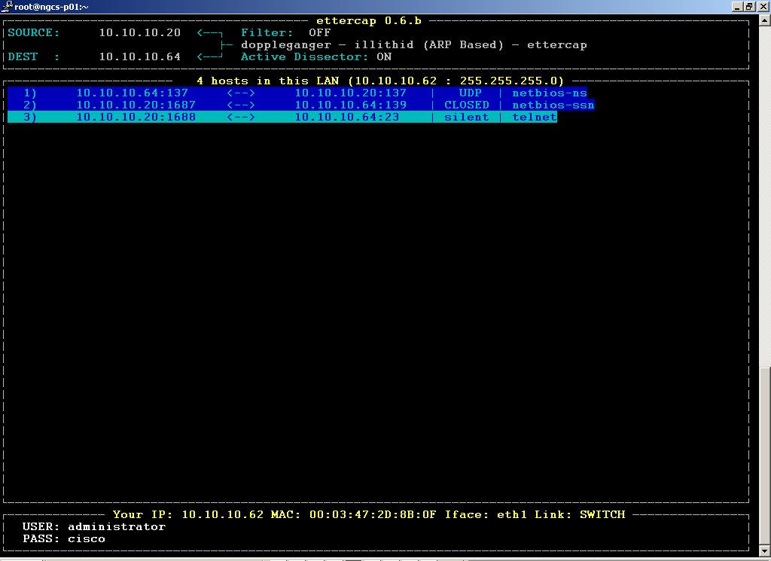
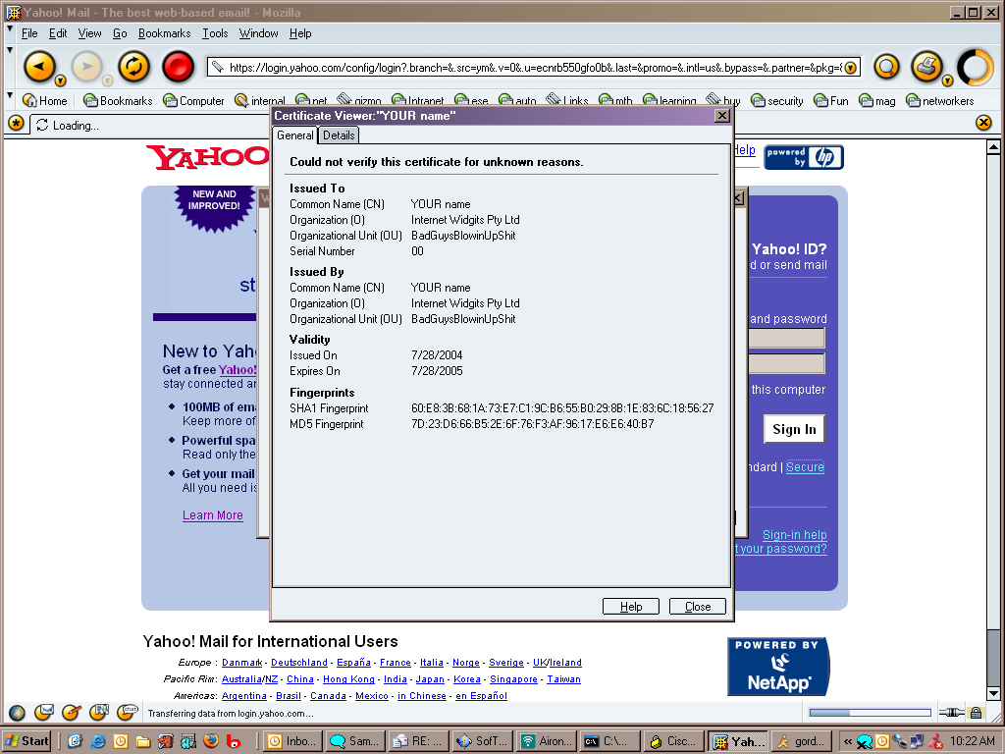
ARP Attack Tools
Many tools on the net for ARP man-in-the-middle attacks
Dsniff, Cain & Abel, ettercap, Yersinia, etc.
ettercap: http://ettercap.sourceforge.net/index.php
Decodes passwords on the fly
Most have a very nice GUI, and is almost point and click
Packet insertion, many to many ARP attack
All of them capture the traffic/passwords of common applications
SSL/SSH sessions can be intercepted and bogus certificate credentials can be presented to perform MITM attack

Slide 35
ARP Attack in Action
Attacker “poisons” the ARP tables
10.1.1.2 Is Now MAC C
10.1.1.1
MAC A
ARP 10.1.1.1 Saying
10.1.1.2 Is MAC C
ARP 10.1.1.2 Saying
10.1.1.1 Is MAC C
10.1.1.3
MAC C
10.1.1.2
MAC B
10.1.1.1 Is Now MAC C

Slide 36
ARP Attack in Action
All traffic flows through the attacker
10.1.1.2 Is Now MAC C
10.1.1.1
MAC A
Transmit/Receive Traffic to
10.1.1.2 MAC C
Transmit/Receive
Traffic to
10.1.1.1 MAC C
10.1.1.3
MAC C
10.1.1.2
MAC B
10.1.1.1 Is Now MAC C

Slide 37
ARP Attack Clean Up
Attacker corrects ARP tables entries
Traffic flows return to normal
10.1.1.2 Is Now MAC B
10.1.1.1
MAC A
ARP 10.1.1.1 Saying
10.1.1.2 Is MAC B
ARP 10.1.1.2 Saying
10.1.1.1 Is MAC A
10.1.1.3
MAC C
10.1.1.2
MAC B
10.1.1.1 Is Now MAC A

Slide 38
Countermeasures to ARP Attacks: Dynamic ARP Inspection (DAI)
Uses the DHCP snooping binding table information
Dynamic ARP inspection
All ARP packets must match the IP/MAC binding table entries
If the entries do not match, throw them in the bit bucket
10.1.1.1
MAC A
Is This Is My Binding Table?
ARP 10.1.1.1 Saying
10.1.1.2 Is MAC C
NO
None Matching ARPs in the Bit Bucket
DHCP Snooping- Enabled Dynamic ARP Inspection- Enabled
10.1.1.3
MAC C
10.1.1.2
MAC B
ARP 10.1.1.2 Saying
10.1.1.1 Is MAC C

Slide 39
Countermeasures to ARP Attacks: Dynamic ARP Inspection
For Cisco devices, DHCP snooping has to be configured so the binding table is built
DAI is configured by VLAN
You can trust an interface like DHCP snooping
Looks at the MAC address and IP address fields to see if the ARP from the interface is in the binding; if not, traffic is blocked
sh ip dhcp snooping binding
MacAddress IpAddress Lease(sec) Type VLAN Interface
------------------ --------------- ---------- ------------- ---- --------------------
00:03:47:B5:9F:AD 10.120.4.10 193185 dhcp-snooping 4 FastEthernet3/18

Slide 40
Spoofing Attacks

Slide 41
Spoofing Attacks
MAC spoofing
If MACs are used for network access an attacker can gain access to the network
Also can be used to take over someone’s identity already on the network
IP spoofing
Ping of death
ICMP unreachable storm
SYN flood
Trusted IP addresses can be spoofed

Slide 42
Spoofing Attack: MAC
Received Traffic
Source Address
10.1.1.3
Mac B
Attacker sends packets with the incorrect source MAC address
If network control is by MAC address, the attacker now looks like 10.1.1.2
10.1.1.1
MAC A
Traffic Sent with MAC B Source
10.1.1.3
MAC C
10.1.1.2
MAC B

Slide 43
Spoofing Attack: IP
Received Traffic
Source IP
10.1.1.2
Mac C
Attacker sends packets with the incorrect source IP address
Whatever device the packet is sent to will never reply to the attacker
10.1.1.1
MAC A
Traffic Sent with IP 10.1.1.2
Source
10.1.1.3
MAC C
10.1.1.2
MAC B

Slide 44
Spoofing Attack: IP/MAC
Received Traffic
Source IP
10.1.1.2
Mac B
Attacker sends packets with the incorrect source IP and MAC address
Now looks like a device that is already on the network
10.1.1.1
MAC A
Traffic Sent with IP
10.1.1.2
MAC B Source
10.1.1.3
MAC C
10.1.1.2
MAC B

Slide 45
Countermeasures to Spoofing Attacks: IP Source Guard
Uses the DHCP snooping binding table information
IP Source Guard
Operates just like dynamic ARP inspection, but looks at every packet, not just ARP packet
10.1.1.1
MAC A
Traffic Sent with
IP 10.1.1.3
Mac B
Nonmatching Traffic Dropped
Is This Is My Binding Table?
NO
10.1.1.3
MAC C
10.1.1.3
MAC C
10.1.1.2
MAC B
Traffic Sent with IP 10.1.1.2
Mac C
Received Traffic Source IP 10.1.1.2
Mac B

Slide 46
Countermeasures to Spoofing Attacks: IP Source Guard
Uses the information from the DHCP snooping binding table
Looks at the MacAddress and IpAddress fields to see if the traffic from the interface is in the binding table, it not, traffic is blocked
sh ip dhcp snooping binding
MacAddress IpAddress Lease(sec) Type VLAN Interface
------------------ --------------- ---------- ------------- ---- --------------------
00:03:47:B5:9F:AD 10.120.4.10 193185 dhcp-snooping 4 FastEthernet3/18

Slide 47
Countermeasures to Spoofing Attacks: IP Source Guard
DHCP snooping has to be configured so the binding table it built
IP Source Guard is configured by port
IP Source Guard with MAC does not learn the MAC from the device connected to the switch, it learns it from the DHCP traffic
Drawbacks
Not supported on all hardware
Resource intensive as it inspects all packets

Slide 48
Attacks on other Protocols

Slide 49
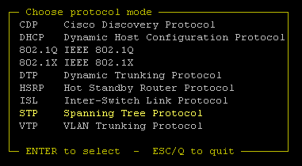
Other Protocols?
Yersinia can help you with:
CDP
DHCP
802.1Q
802.1X
DTP
HSRP
STP
ISL
VTP

Slide 50
Spanning Tree Basics
STP purpose: to maintain loop-free topologies in a redundant Layer 2 infrastructure
STP is very simple; messages are sent using Bridge Protocol Data Units (BPDUs); basic messages include: configuration, topology change notification/acknowledgment (TCN/TCA); most have no “payload”
Avoiding loops ensures broadcast traffic does not become storms
A Switch Is Elected as Root
Root Selection Is Based on the Lowest Configured Priority of Any Switch 0–65535
Root
A ‘Tree-Like’, Loop-Free Topology Is Established from the Perspective of the Root Bridge
X

Slide 51
Spanning Tree Attack Example
Access Switches
Send BPDU messages to become root bridge
Root
STP
STP
X
Blocked

Slide 52
Spanning Tree Attack Example
Access Switches
Send BPDU messages to become root bridge
The attacker then sees frames he shouldn’t
MITM, DoS, etc. all possible
Any attack is very sensitive to the original topology, trunking, PVST, etc.
Although STP takes link speed into consideration, it is always done from the perspective of the root bridge; taking a Gb backbone to half-duplex 10 Mb was verified
Requires attacker is dual homed to two different switches (with a hub, it can be done with just one interface on the attacking host)
Root
Blocked
X
Root

Slide 53
STP Attack Mitigation
Enable BPDU Guard on access ports
BPDU Guard disables the port upon BPDU reception
Called “BPDU Protection” in Juniper devices
Design loop-free topologies where ever possible, so you do not need STP (difficult due to redundancy reasons)
Disable ports using portfast upon detection of a BPDU message on the port
Root Guard
Limits which devices are allowed to be root
Allows a device to participate in STP unless the device attempts to become root bridge due to their BPDU advertisement
Configured on a per port basis

